Slide 1

Financial Computation in C/C++

Slide 2

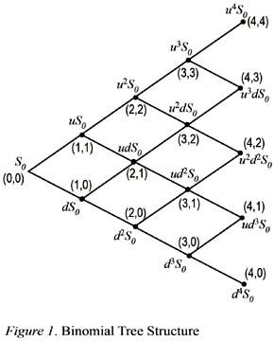
Binomial Model
at step n and node i,
where S(0) > 0, U > D > -1
and n >= i >= 0

Slide 3
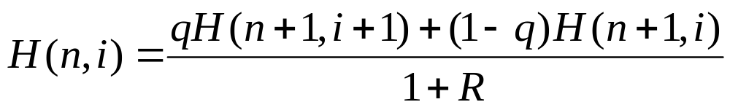
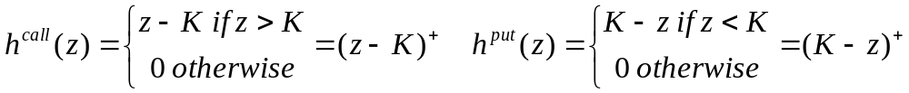
Cox-Ross-Rubinstein (CRR) procedure
At the expiry date N, H(N, i) = h(S(N,i)), for each node i = 0, 1, …, N
If H(n+1, i) is already known at each node i = 0, 1, …, n+1 for some n = 0, 1, …N-1, then for each i = 0, 1, …,n
q = (R-D)/(U-D) is the risk-neutral probability
The payoff functions
Notes:
The risk-neutral measure, (also called an equilibrium measure, or equivalent martingale measure), is a probability measure such that each share price is exactly equal to the discounted expectation of the share price under this measure.

Slide 4
The Structured Programming
Structured programming is a technique which arose from the analysis of the flow control structures which underlie all computer programs. It is possible to construct any flow control structure from three basic structures: sequential, conditional and iterative. We will use the structured programming to price European options via the binomial model.

Slide 5

C/C++ Development Environment

Slide 6


Slide 7


Slide 8
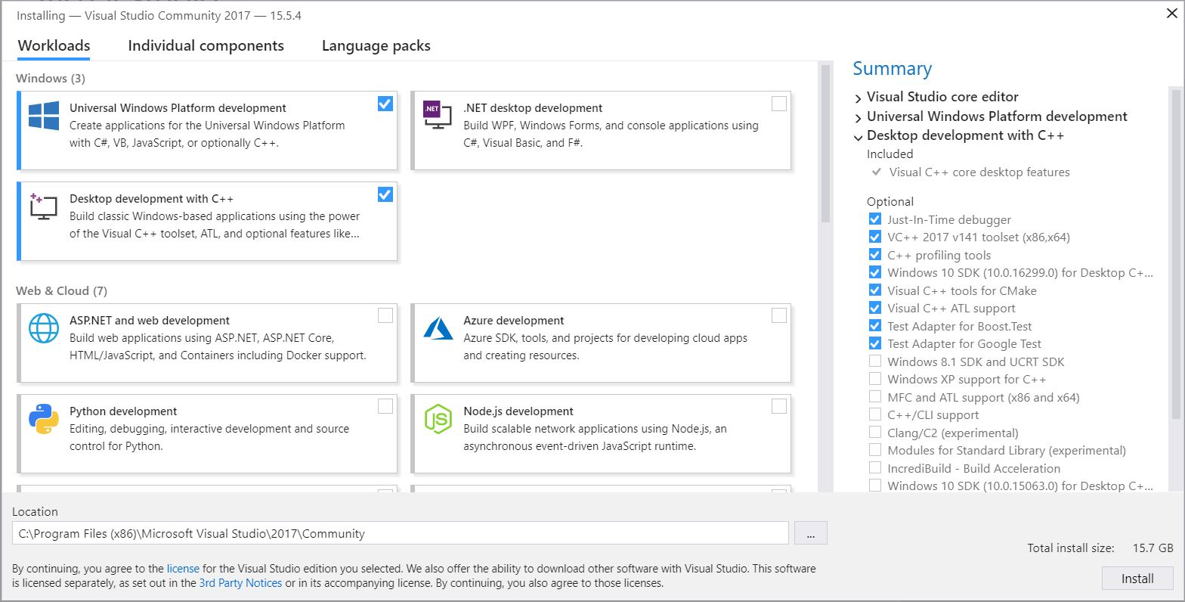

Slide 9
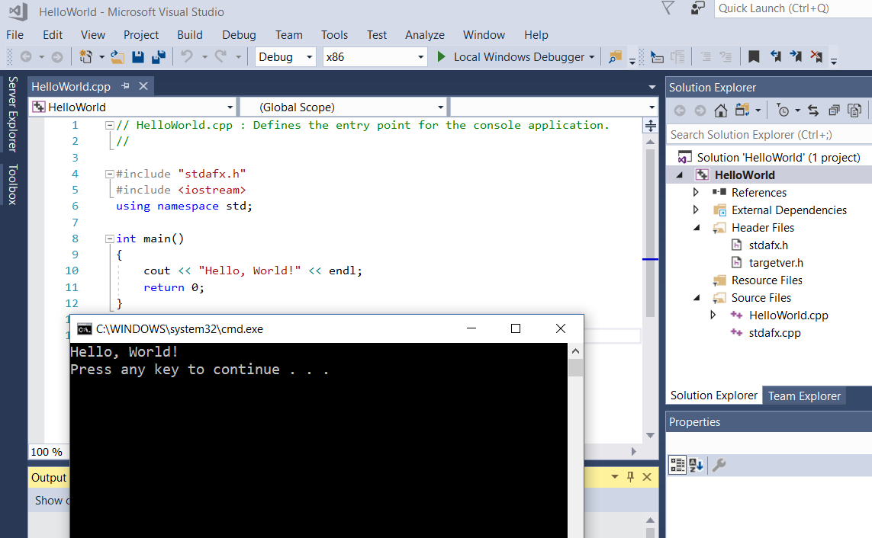

Slide 10
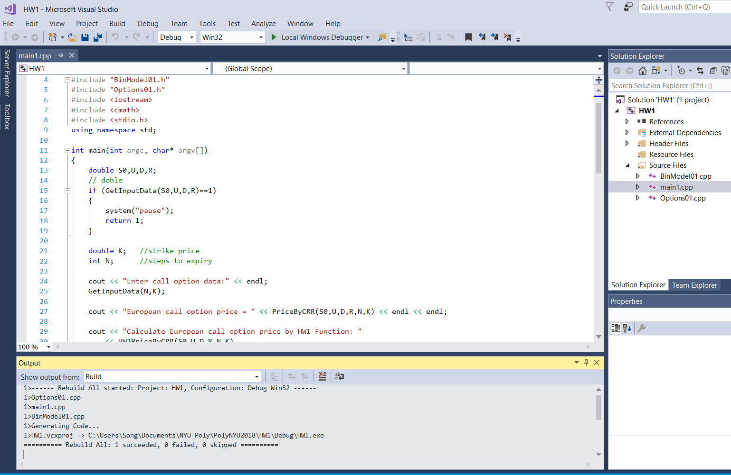

Slide 11
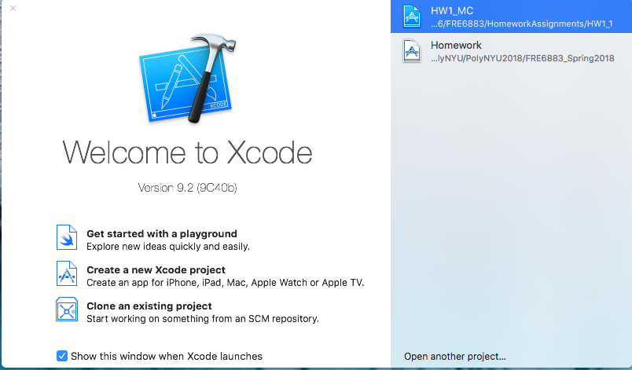
C/C++ Development Environment

Slide 12
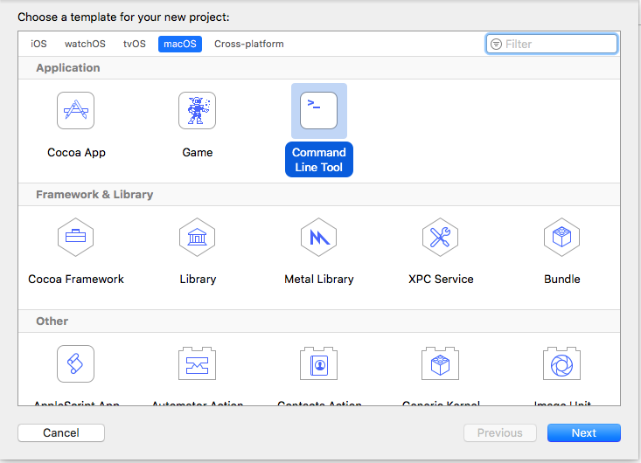

Slide 13
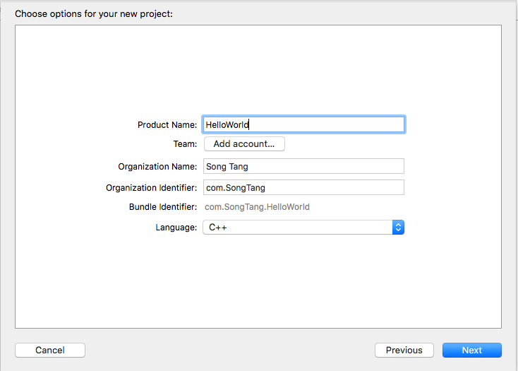

Slide 14
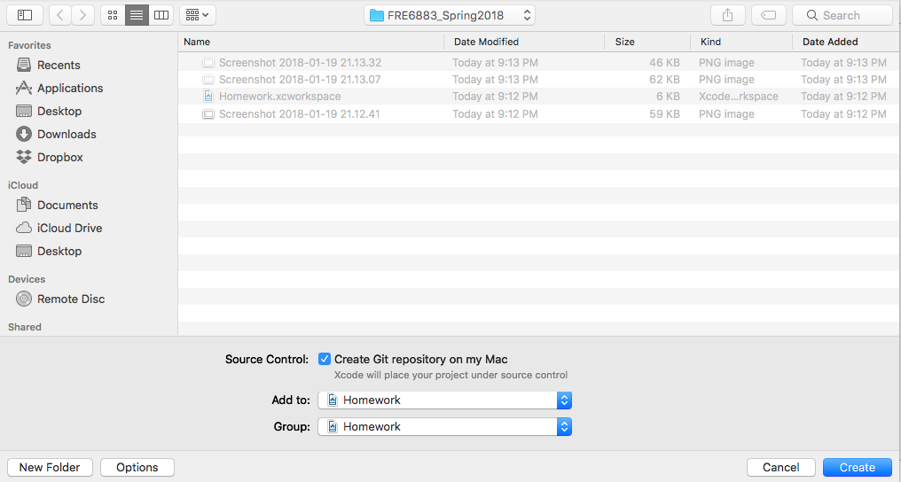

Slide 15
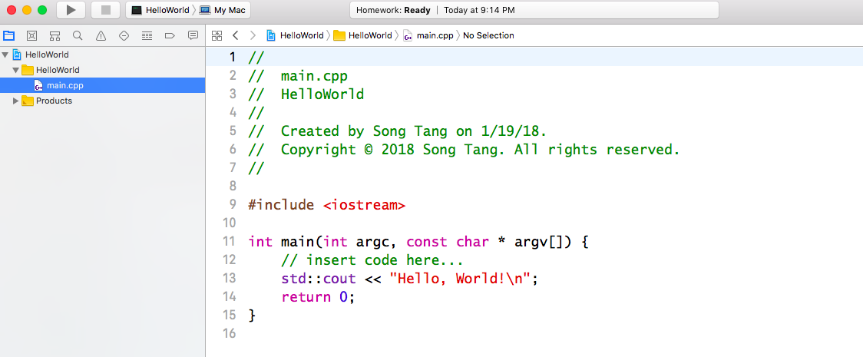
Scope operator
Newline character

Slide 16
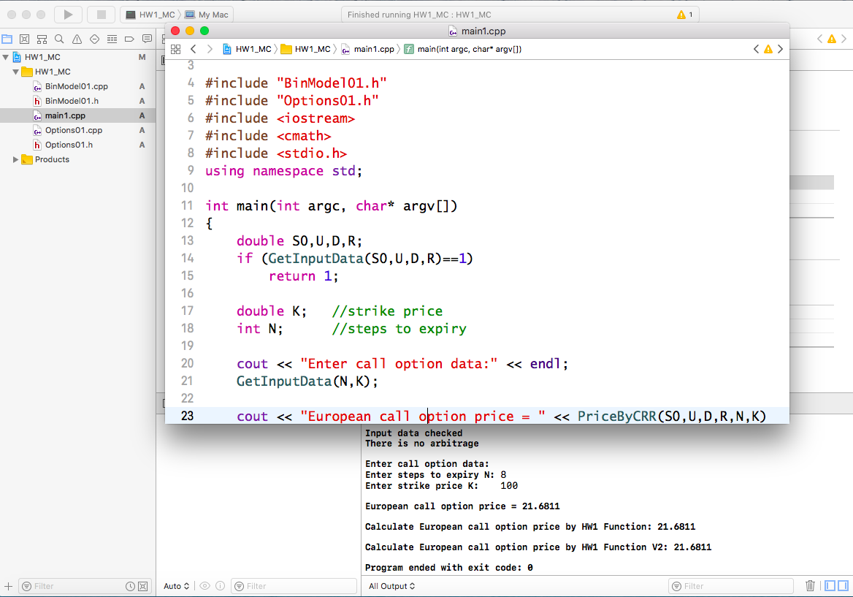

Slide 17
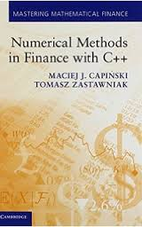
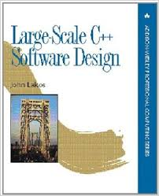
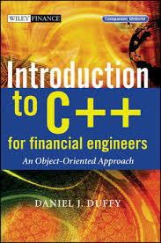

Slide 18
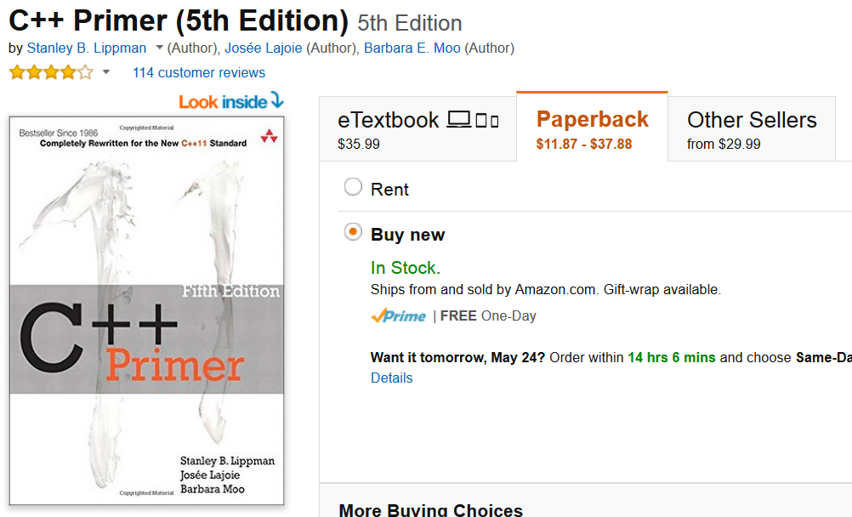
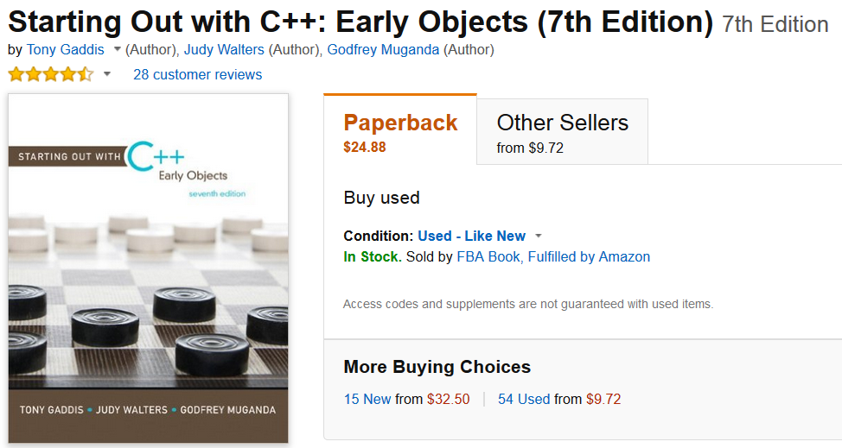

Slide 19
Our first C program
#include <iostream>
using namespace std;
int main()
{
//display message
cout << “Hello World!” << endl;
//pause program
char x; cin >> x;
return 0;
}

Slide 20
#include <iostream>
Namespaces
int main()
Comments
Input and output operators
variables

Slide 21
Binomial Pricer
Listing 1.2 Main02.cpp
  Using binomial tree for asset pricing
  Compute and display the stock price S(n,i) = S(0)(1+U)^{i}(1+D)^{n-i}
  cout << "S(n,i) = " << S0*pow(1+U,i)*pow(1+D,n-i)<< endl;
cmath

Slide 22
Main02.cpp
#include <iostream>
#include <cmath>
using namespace std;
int main()
{
double S0,U,D,R;
//entering data
cout << "Enter S0: "; cin >> S0;
cout << "Enter U: "; cin >> U;
cout << "Enter D: "; cin >> D;
cout << "Enter R: "; cin >> R;
cout << endl;
//making sure that 0<S0, -1<D<U, -1<R
if (S0<=0.0 || U<=-1.0 || D<=-1.0 || U<=D || R<=-1.0)
{ cout << "Illegal data ranges" << endl;
cout << "Terminating program" << endl;
return 1; }
//checking for arbitrage
if (R>=U || R<=D)
{ cout << "Arbitrage exists" << endl;
cout << "Terminating program" << endl;
return 1; }
cout << "Input data checked" << endl;
cout << "There is no arbitrage" << endl << endl;
//compute risk-neutral probability
cout << "q = " << (R-D)/(U-D) << endl;
//compute stock price at node n=3,i=2
int n=3; int i=2;
cout << "n = " << n << endl;
cout << "i = " << i << endl;
cout << "S(n,i) = " << S0*pow(1+U,i)*pow(1+D,n-i) << endl;
return 0;
}

Slide 23
Functions
//computing risk-neutral probability
double RiskNeutProb(double U, double D, double R)
//computing the stock price at node n,i
double S(double S0, double U, double D, int n, int i)
//inputting, displaying and checking model data
int GetInputData(double& S0, double& U, double& D, double& R)
“passed by value” vs. “passed by reference”

Slide 24
Main03.cpp
#include <iostream>
#include <cmath>
using namespace std;
//computing risk-neutral probability
double RiskNeutProb(double U, double D, double R)
{
return (R-D)/(U-D);
}
//computing the stock price at node n,i
double S(double S0, double U, double D, int n, int i)
{
return S0*pow(1+U,i)*pow(1+D,n-i);
}

Slide 25
// inputting, displaying and
// checking model data
int GetInputData(double& S0, double& U, double& D, double& R)
{
//entering data
cout << "Enter S0: "; cin >> S0;
cout << "Enter U: "; cin >> U;
cout << "Enter D: "; cin >> D;
cout << "Enter R: "; cin >> R;
cout << endl;
//making sure that 0<S0, -1<D<U, -1<R
if (S0<=0.0 || U<=-1.0 || D<=-1.0 || U<=D|| R<=-1.0)
{ cout << "Illegal data ranges" << endl;
cout << "Terminating program" << endl;
return 1; }
//checking for arbitrage
if (R>=U || R<=D)
{ cout << "Arbitrage exists" << endl;
cout << "Terminating program" << endl;
return 1; }
cout << "Input data checked" << endl;
cout << "There is no arbitrage" << endl << endl;
return 0;
}

Slide 26
int main()
{
double S0,U,D,R;
if (GetInputData(S0,U,D,R)==1) return 1;
//compute risk-neutral probability
cout << "q = " << RiskNeutProb(U,D,R) << endl;
//compute stock price at node n=3,i=2
int n=3; int i=2;
cout << "n = " << n << endl;
cout << "i = " << i << endl;
cout << "S(n,i) = " << S(S0,U,D,n,i) << endl;
return 0;
}

Slide 27
Separate Compilation
BinModel01.h
  #ifndef BinModel01_h
  #define BinModel01_h
  …..
  #endif
BinModel01.cpp
Main04.cpp

Slide 28
BinModel01.h
#ifndef BinModel01_h
#define BinModel01_h
//computing risk-neutral probability
double RiskNeutProb(double U, double D, double R);
//computing the stock price at node n,i
double S(double S0, double U, double D, int n, int i);
//inputting, displaying and checking model data
int GetInputData(double& S0, double& U, double& D, double& R);
#endif

Slide 29
BinModel01.cpp
#include "BinModel01.h"
#include <iostream>
#include <cmath>
using namespace std;
double RiskNeutProb(double U, double D, double R)
{
return (R-D)/(U-D);
}
double S(double S0, double U, double D, int n, int i)
{
return S0*pow(1+U,i)*pow(1+D,n-i);
}
int GetInputData(double& S0, double& U, double& D, double& R)
{ ….. }

Slide 30
CRR Pricer
Within the binomial model the price H(n,i) at each time step n and node i of an European option with expiry date N and payoff h(S(N)) can be computed using the Cox-Ross-Rubistein (CRR) procedure.
Options01.h
  Funtion overloading and array

Slide 31
CRR Pricer Continued
#ifndef Options01_h
#define Options01_h
//inputting and displaying option data
int GetInputData(int& N, double& K);
//pricing European option
double PriceByCRR(double S0, double U, double D, double R, int N, double K);
//computing call payoff
double CallPayoff(double z, double K);
#endif

Slide 32
CRR Pricer Continued
Function prototypes
Function overloading
Sequential, Conditional and Iterative.
C++ array

Slide 33
Options01.cpp
#include "Options01.h"
#include "BinModel01.h"
#include <iostream>
#include <cmath>
using namespace std;
int GetInputData(int& N, double& K)
{ cout << "Enter steps to expiry N: "; cin >> N;
cout << "Enter strike price K: "; cin >> K;
cout << endl;
return 0; }
double CallPayoff(double z, double K)
{ if (z>K) return z-K;
return 0.0;
}

Slide 34
double PriceByCRR(double S0, double U, double D, double R, int N, double K)
{
double q=RiskNeutProb(U,D,R);
double Price[N+1];
for (int i=0; i<=N; i++)
{
Price[i]=CallPayoff(S(S0,U,D,N,i),K);
}
for (int n=N-1; n>=0; n--)
{
for (int i=0; i<=n; i++)
{
Price[i]=(q*Price[i+1]+(1-q)*Price[i])/(1+R);
}
}
return Price[0];
}

Slide 35
Main05.cpp
#include "BinModel01.h"
#include "Options01.h"
#include <iostream>
#include <cmath>
using namespace std;
int main()
{
double S0,U,D,R;
if (GetInputData(S0,U,D,R)==1) return 1;
double K; //strike price
int N; //steps to expiry
cout << "Enter call option data:" << endl;
GetInputData(N,K);
cout << "European call option price = " << PriceByCRR(S0,U,D,R,N,K) << endl << endl;
return 0;
}

Slide 36
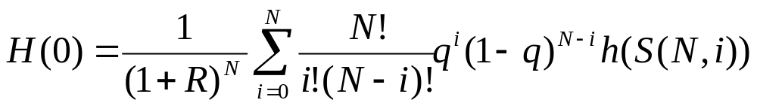
Homework Assignment
Modify the PriceByCRR() function in Options01.cpp to compute the time 0 price of an European option using CRR formula:

Slide 37
Pointers
A pointer is a variable used to store an address in computer memory
  Options02.h
  Options02.cpp
  Main06.cpp

Slide 38
Pointers and the Address Operator
Each variable in a program is stored at a unique address in memory
Use the address operator & to get the address of a variable:
  int num = -23;
  cout << &num; // prints address in hexadecimal
The address of a memory location is a pointer, i.e. pointers provide a way to access memory locations

Slide 39
Pointer Variables
Pointer variable (pointer): variable that holds an address
Definition:
  int *intptr;
Read as:
“intptr can hold the address of an int” or
“the variable that intptr points to has type int”
Spacing in definition does not matter:
  int * intptr;
  int* intptr;

Slide 40
Pointer Variables
Assignment:
int num = 25;
int *intptr;
intptr = &num;
Memory layout:
Can access num using intptr and indirection operator *:
cout << intptr; // prints 0x4a00
cout << *intptr; // prints 25
num
intptr
25
0x4a00
address of num: 0x4a00

Slide 41
The Relationship Between Arrays and Pointers
Array name is starting address of array
  int vals[] = {4, 7, 11};
  cout << vals; // displays 0x4a00
  cout << vals[0]; // displays 4
4 | 7 | 11
starting address of vals: 0x4a00

Slide 42
The Relationship Between Arrays and Pointers
Array name can be used as a pointer constant
  int vals[] = {4, 7, 11};
  cout << *vals; // displays 4
Pointer can be used as an array name
  int *valptr = vals;
  cout << valptr[1]; // displays 7

Slide 43
Pointers in Expressions
Given:
  int vals[]={4,7,11};
  int *valptr = vals;
What is valptr + 1?
It means (address in valptr) + (1 * size of an int)
  cout << *(valptr+1); // displays 7
  cout << *(valptr+2); // displays 11
Must use ( ) in expression
10-<number>

Slide 44
Array Access
Array elements can be accessed in many ways
Array access method | Example
array name and [ ] | vals[2] = 17;
pointer to array and [ ] | valptr[2] = 17;
array name and subscript arithmetic | *(vals+2) = 17;
pointer to array and subscript arithmetic | *(valptr+2) = 17;

Slide 45
Array Access
Array notation
vals[i]
is equivalent to the pointer notation
*(vals + i)
No bounds checking performed on array access

Slide 46
Pointer Arithmetic
Some arithmetic operators can be used with pointers:
  Increment and decrement operators ++, --
  Integers can be added to or subtracted from pointers using the operators +, -, +=, and -=
  One pointer can be subtracted from another by using the subtraction operator -

Slide 47
Pointer Arithmetic
Assume the variable definitions
int vals[]={4,7,11};
int *valptr = vals;
Examples of use of ++ and --
valptr++; // points at 7
valptr--; // now points at 4

Slide 48
More on Pointer Arithmetic
Assume the variable definitions:
int vals[]={4,7,11};
int *valptr = vals;
Example of the use of + to add an int to a pointer:
cout << *(valptr + 2)
This statement will print 11
10-<number>

Slide 49
More on Pointer Arithmetic
Assume the variable definitions:
int vals[]={4,7,11};
int *valptr = vals;
Example of use of +=:
valptr = vals; // points at 4
valptr += 2; // points at 11
10-<number>

Slide 50
More on Pointer Arithmetic
Assume the variable definitions
int vals[] = {4,7,11};
int *valptr = vals;
Example of pointer subtraction
valptr += 2;
cout << valptr - vals;
This statement prints 2: the number of
ints between valptr and val

Slide 51
Pointer Initialization
Can initialize to NULL or 0 (zero)
int *ptr = NULL;
Can initialize to addresses of other variables
  int num, *numPtr = &num;
  int val[ISIZE], *valptr = val;
Initial value must have correct type
  float cost;
  int *ptr = &cost; // won't work

Slide 52
Comparing Pointers
Relational operators can be used to compare addresses in pointers
Comparing addresses in pointers is not the same as comparing contents pointed at by pointers:
  if (ptr1 == ptr2) // compares
  // addresses
  if (*ptr1 == *ptr2) // compares
  // contents

Slide 53
Pointers as Function Parameters
A pointer can be a parameter
Works like a reference parameter to allow change to argument from within function
A pointer parameter must be explicitly dereferenced to access the contents at that address

Slide 54
Pointers as Function Parameters
Requires:
1) asterisk * on parameter in prototype and
heading
  void getNum(int *ptr);
2) asterisk * in body to dereference the pointer
cin >> *ptr;
3) address as argument to the function
  getNum(&num);

Slide 55
Pointers as Function Parameters
void swap(int *x, int *y)
{
int temp;
temp = *x;
*x = *y;
*y = temp;
}
int num1 = 2, num2 = -3;
swap(&num1, &num2);

Slide 56
Pointers to Constants and Constant Pointers
Pointer to a constant: cannot change the value that is pointed at.
Constant pointer: address in pointer cannot change once pointer is initialized.

Slide 57
Ponters to Constant
Must use const keyword in pointer definition:
  const double taxRates[] =
  {0.65, 0.8, 0.75};
  const double *ratePtr;
Use const keyword for pointers in function headers to protect data from modification from within function

Slide 58
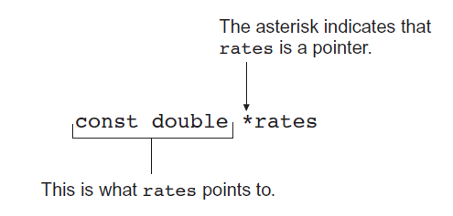
Pointer to Constant – What does the Definition Mean?

Slide 59
Constant Pointers
Defined with const keyword adjacent to variable name:
  int classSize = 24;
  int * const classPtr = &classSize;
Must be initialized when defined
Can be used without initialization as a function parameter
  Initialized by argument when function is called
  Function can receive different arguments on different calls
While the address in the pointer cannot change, the data at that address may be changed

Slide 60
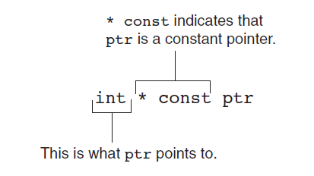
Constant Pointer – What does the Definition Mean?

Slide 61
Dynamic Memory Allocation
Can allocate storage for a variable while program is running
Uses new operator to allocate memory
  double *dptr;
  dptr = new double;
new returns address of memory location

Slide 62
Dynamic Memory Allocation
Can also use new to allocate array
  arrayPtr = new double[25];
  Program often terminates if there is not sufficient memory
Can then use [ ] or pointer arithmetic to access array

Slide 63
Releasing Dynamic Memory
Use delete to free dynamic memory
  delete dptr;
Use delete [] to free dynamic array memory
  delete [] arrayptr;
Only use delete with dynamic memory!

Slide 64
Dangling Pointers and Memory Leaks
A pointer is dangling if it contains the address of memory that has been freed by a call to delete.
  Solution: set such pointers to 0 as soon as memory is freed.
A memory leak occurs if no-longer-needed dynamic memory is not freed. The memory is unavailable for reuse within the program.
  Solution: free up dynamic memory after use

Slide 65
Returning Pointers from Functions
Pointer can be return type of function
  int* newNum();
Function must not return a pointer to a local variable in the function
Function should only return a pointer
  to data that was passed to the function as an argument
  to dynamically allocated memory

Slide 66
Pointers to Class Objects and Structures
Can create pointers to objects and structure variables
  struct Student {…};
  class Square {…};
  Student stu1;
  Student *stuPtr = &stu1;
  Square sq1[4];
  Square *squarePtr = &sq1[0];
Need () when using * and .
  (*stuPtr).studentID = 12204;

Slide 67
Structure Pointer Operator
Simpler notation than (*ptr).member
Use the form ptr->member:
  stuPtr->studentID = 12204;
  squarePtr->setSide(14);
  in place of the form (*ptr).member:
  (*stuPtr).studentID = 12204;
  (*squarePtr).setSide(14);

Slide 68
Dynamic Memory with Objects
Can allocate dynamic structure variables and objects using pointers:
  stuPtr = new Student;
Can pass values to constructor:
  squarePtr = new Square(17);
delete causes destructor to be invoked:
  delete squarePtr;

Slide 69
Selecting Members of Objects
Situation: A structure/object contains a pointer as a member. There is also a pointer to the structure/ object.
Problem: How do we access the pointer member via the structure/object pointer?
  struct GradeList
  { string courseNum;
  int * grades;
  }
  GradeList test1, *testPtr = &test1;

Slide 70
Selecting Members of Objects
Expression | Meaning
testPtr->grades | Access the grades pointer in test1. This is the same as (*testPtr).grades
*testPtr->grades | Access the value pointed at by testPtr->grades. This is the same as *(*testPtr).grades
*test1.grades | Access the value pointed at by test1.grades

Slide 71
Options02.h
#ifndef Options02_h
#define Options02_h
//inputting and displaying option data
int GetInputData(int* PtrN, double* PtrK);
//pricing European option
double PriceByCRR(double S0, double U, double D, double R, int N, double K);
//computing call payoff
double CallPayoff(double z, double K);
#endif

Slide 72
Options02.cpp
#include "Options02.h"
#include "BinModel01.h"
#include <iostream>
#include <cmath>
using namespace std;
int GetInputData(int* PtrN, double* PtrK)
{ cout << "Enter steps to expiry N: "; cin >> *PtrN;
cout << "Enter strike price K: "; cin >> *PtrK;
cout << endl;
return 0;
}
double CallPayoff(double z, double K)
{ if (z>K) return z-K;
return 0.0;
}

Slide 73
double PriceByCRR(double S0, double U, double D, double R, int N, double K)
{
double q=RiskNeutProb(U,D,R);
double Price[N+1];
for (int i=0; i<=N; i++)
{
*(Price+i)=CallPayoff(S(S0,U,D,N,i),K);
}
for (int n=N-1; n>=0; n--)
{
for (int i=0; i<=n; i++)
{
*(Price+i)=(q*(*(Price+i+1))+(1-q)*(*(Price+i)))/(1+R);
}
}
return *Price;
}

Slide 74
Main06.cpp
#include "BinModel01.h"
#include "Options02.h"
#include <iostream>
#include <cmath>
using namespace std;
int main()
{
double S0,U,D,R;
if (GetInputData(S0,U,D,R)==1) return 1;
double K; //strike price
int N; //steps to expiry
cout << "Enter call option data:" << endl;
GetInputData(&N,&K);
cout << "European call option price = “ << PriceByCRR(S0,U,D,R,N,K) << endl << endl;
return 0;
}

Slide 75
Function Pointers
What we want is the ability to add new payoff functions without having to retouch the definition of PriceByCRR(). Function pointers offer a way to achieve it:
  double PriceByCRR(double S0, double U, double D,
double R, int N, double K,
double (*Payoff)(double z, double K));

Slide 76
Options03.h
#ifndef Options03_h
#define Options03_h
//inputting and displaying option data
int GetInputData(int& N, double& K);
//pricing European option
double PriceByCRR(double S0, double U, double D, double R, int N, double K,
double (*Payoff)(double z, double K));
//computing call payoff
double CallPayoff(double z, double K);
//computing put payoff
double PutPayoff(double z, double K);
#endif

Slide 77
Options03.cpp
#include "Options03.h"
#include "BinModel01.h"
#include <iostream>
#include <cmath>
using namespace std;
int GetInputData(int& N, double& K)
{ cout << "Enter steps to expiry N: "; cin >> N;
cout << "Enter strike price K: "; cin >> K;
cout << endl;
return 0; }
double CallPayoff(double z, double K)
{ if (z>K) return z-K;
return 0.0;
}
double PutPayoff(double z, double K)
{ if (z<K) return K-z;
return 0.0; }

Slide 78
double PriceByCRR(double S0, double U, double D, double R, int N, double K,
double (*Payoff)(double z, double K))
{
double q=RiskNeutProb(U,D,R);
double Price[N+1];
for (int i=0; i<=N; i++)
{
Price[i]=Payoff(S(S0,U,D,N,i),K);
}
for (int n=N-1; n>=0; n--)
{
for (int i=0; i<=n; i++)
{
Price[i]=(q*Price[i+1]+(1-q)*Price[i])/(1+R);
}
}
return Price[0];
}

Slide 79
Main07.cpp
#include "BinModel01.h"
#include "Options03.h"
#include <iostream>
#include <cmath>
using namespace std;
int main()
{
double S0,U,D,R;
if (GetInputData(S0,U,D,R)==1) return 1;
double K; //strike price
int N; //steps to expiry
cout << "Enter call option data:" << endl;
GetInputData(N,K);
cout << "European call option price = “ << PriceByCRR(S0,U,D,R,N,K,CallPayoff) << endl << endl;
cout << "Enter put option data:" << endl;
GetInputData(N,K);
cout << "European put option price = " << PriceByCRR(S0,U,D,R,N,K,PutPayoff) << endl << endl;
return 0;
}

Slide 80
Homework Assignment
Include the ability to price digital calls and puts in the program developed in the present section by adding new payoff functions to the files Options03.h, Options03.cpp and Main07.cpp
All what we have done so far is know as the Procedural style of programming.

Slide 81
To Do List
Price a double-digital option
Include American Options
How about path-dependent options? A barrier option? An Asian option?
Compute the hedging portfolio on top of the price
Compute the price from the Black-Scholes formula.

Slide 82
To Do List (continued)
Approximate the Black-Scholes price by the CRR price
Include a Monte Carlo Pricer
To Handle the increasing complexity, we need a more powerful way: Object-Oriented Programming

Slide 83
Object-Oriented Programming in C++
We will use C++ for demonstrating object oriented programming and implement a C++ application based on what we have done in structured programming. In other words, we will recast the option pricer in the style of object-oriented programming. The C++ classes will reflect the relationships between real entities, namely the binomial model and European options of various kinds.

Slide 84
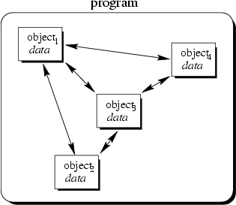
Object-Oriented Concept

Slide 85
Objects
An object is an encapsulation of both functions and data
Objects are an Abstraction
  represent real world entities
  Classes are data types that define shared common properties or attributes
  Objects are instances of a class
Objects have State
  have a value at a particular time
Objects have Operations
  associated set of operations called methods that describe how to carry out operations

Slide 86
OO Perspective
Let's look at the Rectangle through object oriented eyes:
Define a new type Rectangle (a class)
  Data
    width, length
  Function
    area()
Create an instance of the class (an object)
Request the object for its area
In C++, rather than writing a procedure, we define a class that encapsulates the knowledge necessary to answer the question - here, what is the area of the rectangle.

Slide 87
Example Object Oriented Code
class Rectangle
{
private:
int width, length;
public:
Rectangle(int w, int l)
{
width = w;
length = l;
}
int area()
{
return width*length;
}
};
void main()
{
Rectangle rect(3, 5);
cout << rect.area()<<endl;
}

Slide 88
Object-Oriented Programming Languages
Characteristics of OOPL:
  Encapsulation
  Inheritance
  Polymorphism
OOPLs support :
  Modular Programming
  Ease of Development
  Maintainability

Slide 89
Characteristics of OOPL
Encapsulation: Combining data structure with actions
  Data structure: represents the properties, the state, or characteristics of objects
  Actions: permissible behaviors that are controlled through the member functions
Data hiding: Process of making certain data inaccessible
Inheritance: Ability to derive new objects from old ones
  permits objects of a more specific class to inherit the properties (data) and behaviors (functions) of a more general/base class
  ability to define a hierarchical relationship between objects
Polymorphism: Ability for different objects to interpret functions differently

Slide 90
Define a Class Type
class class_name
{
permission_label:
member;
permission_label:
member;
...
};
class Rectangle
{
private:
int width;
int length;
public:
void set(int w, int l);
int area();
};
Header
Body

Slide 91
Class Definition - Data Members
Can be of any type, built-in or user-defined
non-static data member
  Each class object has its own copy
static data member
  Acts as a global variable
  One copy per class type, e.g. counter

Slide 92
Static Data Member
class Rectangle
{
private:
int width;
int length;
static int count;
public:
void set(int w, int l);
int area();
}
Rectangle r1;
Rectangle r2;
Rectangle r3;
count
r1
r2
width
length
width
length
width
length
r3

Slide 93
Class Definition - Member Functions
Used to
  access the values of the data members (accessor)
  perform operations on the data members (implementor)
Are declared inside the class body
Their definition can be placed inside the class body, or outside the class body
Can access both public and private members of the class
Can be referred to using dot or arrow member access operator

Slide 94
Define a Member Function
class Rectangle
{
private:
int width, length;
public:
void set (int w, int l);
int area() {return width*length; }
};
class name
member function name
void Rectangle :: set (int w, int l)
{
width = w;
length = l;
}
inline
r1.set(5,8);
rp->set(8,10);
scope operator

Slide 95
Class Definition-Member Functions
const member function
  declaration
    return_type func_name (para_list) const;
  definition
    return_type func_name (para_list) const { … }
    return_type class_name :: func_name (para_list) const { … }
  Makes no modification about the data members (safe function)
  It is illegal for a const member function to modify a class data member

Slide 96
Const Member Function
class Time
{
private :
int hrs, mins, secs ;
public :
void Write ( ) const ;
} ;
function declaration
function definition
void Time :: Write( ) const
{
cout <<hrs << “:” << mins << “:” << secs << endl;
}

Slide 97
Class Definition - Access Control
Information hiding
  To prevent the internal representation from direct access from outside the class
Access Specifiers
  public
    may be accessible from anywhere within a program
  private
    may be accessed only by the member functions, and friends of this class
  protected
    acts as public for derived classes
    behaves as private for the rest of the program

Slide 98
class Time Specification
class Time
{
public :
void Set ( int hours , int minutes , int seconds ) ;
void Increment ( ) ;
void Write ( ) const ;
Time ( int initHrs, int initMins, int initSecs ) ; // constructor
Time ( ) ; // default constructor
private :
int hrs ;
int mins ;
int secs ;
} ;

Slide 99
Class Interface Diagram
Time class
Set
Private data:
hrs
mins
secs
Increment
Write
Time
Time

Slide 100
Class Definition - Access Control
The default access specifier is private
The data members are usually private or protected
A private member function is a helper, may only be accessed by another member function of the same class
The public member functions are part of the class interface
Each access control section is optional, repeatable, and sections may occur in any order

Slide 101
What is an object?
OBJECT
set of methods
(member functions)
internal state
(values of private data members)
Operations
Data

Slide 102
Declaration of an Object
class Rectangle
{
private:
int width;
int length;
public:
void set(int w, int l);
int area();
};
main()
{
Rectangle r1;
Rectangle r2;
r1.set(5, 8);
cout<<r1.area()<<endl;
r2.set(8,10);
cout<<r2.area()<<endl;
}

Slide 103
Declaration of an Object
class Rectangle
{
private:
int width;
int length;
public:
void set(int w, int l);
int area();
};
r2 is a pointer to a Rectangle object
main()
{
Rectangle r1;
r1.set(5, 8);
Rectangle *r2;
r2 = &r1;
r2->set(8,10);
}
//dot notation
//arrow notation
5000
r1
r2
width
length
width = 5
length = 8
width = 8
length = 10
6000
???
5000

Slide 104
Declaration of an Object
class Rectangle
{
private:
int width;
int length;
public:
void set(int w, int l);
int area();
};
r3 is dynamically allocated
main()
{
Rectangle *r3;
r3 = new Rectangle();
r3->set(80,100);
delete r3;
r3 = NULL;
}
//arrow notation
r3
6000
5000
???
5000
???
NULL
width
length
width = 80
length = 100

Slide 105
Object Initialization
class Rectangle
{
private:
int width;
int length;
public:
Rectangle();
//call by reference
Rectangle(const Rectangle &r);
Rectangle(int w, int l);
void set(int w, int l);
int area();
}
Default constructor
Copy constructor
Constructor with parameters
They are publicly accessible
Have the same name as the class
There is no return type
Are used to initialize class data
members
They have different signatures
//cannot have Rectangle(Rectangle r) because we don’t have base statement in this way. (recursive forever)

Slide 106
Object Initialization
class Rectangle
{
private:
int width;
int length;
public:
void set(int w, int l);
int area();
};
When a class is declared with no constructors,
the compiler automatically assumes default
constructor and copy constructor for it.
Default constructor
Rectangle :: Rectangle() { };
Copy constructor
Rectangle :: Rectangle (const Rectangle & r)
{
width = r.width; length = r.length;
};

Slide 107
Object Initialization
Initialize with default constructor
class Rectangle
{
private:
int width;
int length;
public:
void set(int w, int l);
int area();
}
Rectangle r1;
Rectangle *r3 = new Rectangle();
Initialize with copy constructor
Rectangle r4;
r4.set(60,80);
Rectangle r5 = r4;
Rectangle r6(r4);
Rectangle *r7 = new Rectangle(r4);

Slide 108
Object Initialization
class Rectangle
{
private:
int width;
int length;
public:
Rectangle(int w, int l)
{width =w; length=l;}
void set(int w, int l);
int area();
}
If any constructor with any number of parameters is declared, no default constructor will exist, unless you define it.
Rectangle r4; // error
Initialize with constructor
Rectangle r5(60,80);
Rectangle *r6 = new Rectangle(60,80);
Notes:
If any constructor with any number of parameters is declared, no default constructor will exist, unless you define it.
But compiler still provides the implicit copy constructor.

Slide 109
Object Initialization
Write your own constructors
class Rectangle
{
private:
int width;
int length;
public:
Rectangle();
Rectangle(int w, int l);
void set(int w, int l);
int area();
}
Rectangle :: Rectangle()
{
width = 20;
length = 50;
};
Rectangle *r7 = new Rectangle();
r7
6000
???
5000
5000
width
length
width = 20
length = 50

Slide 110
Object Initialization
class Account
{
private:
char *name;
double balance;
unsigned int id;
public:
Account();
Account(const Account &a);
Account(const char *person);
}
With constructors, we have more
control over the data members
Account :: Account(const Account &a)
{
name = new char[strlen(a.name)+1];
strcpy (name, a.name);
balance = a.balance;
id = a.id;
};
Account :: Account(const char *person)
{
name = new char[strlen(person)+1];
strcpy (name, person);
balance = 0.0;
id = 0;
};
Account :: Account()
{
name = NULL; balance = 0.0;
id = 0;
};
Notes:
The danger of implicitly created copy constructor:
Account::Account(const Account &a)
{
name = a.name;
}

Slide 111
So far, …
An object can be initialized by a class constructor
  default constructor
  copy constructor
  constructor with parameters
Resources are allocated when an object is initialized
Resources should be revoked when an object is about to end its lifetime

Slide 112
Cleanup of An Object
Destructor
class Account
{
private:
char *name;
double balance;
unsigned int id; //unique
public:
Account();
Account(const Account &a);
Account(const char *person);
~Account();
}
Account :: ~Account()
{
delete[] name;
}
Its name is the class name preceded by a ~ (tilde)
It has no argument
It is used to release dynamically allocated memory and to perform other "cleanup" activities
It is executed automatically when the object goes out of scope

Slide 113
Our First Class
class BinModel
{
private:
double S0;
double U;
double D;
double R;
public:
//computing risk-neutral probability
double RiskNeutProb();
//computing the stock price at node n,i
double S(int n, int i);
//inputting, displaying and checking model data
int GetInputData();
double GetR();
};

Slide 114
Overview
Class BinModel
  Class members
    private members
    public members
    protected members
  Member function declaration & definition

Slide 115
BinModel02.cpp
  #include "BinModel02.h"
  #include <iostream>
  #include <cmath>
  using namespace std;
  double BinModel::RiskNeutProb()
  {
  return (R-D)/(U-D);
  }
  double BinModel::S(int n, int i)
  {
  return S0*pow(1+U,i)*pow(1+D,n-i);
  }
  double BinModel::GetR()
  {
  return R;
  }

Slide 116
BinModel02.cpp (Continue)
int BinModel::GetInputData()
{
//entering data
cout << "Enter S0: "; cin >> S0;
cout << "Enter U: "; cin >> U;
cout << "Enter D: "; cin >> D;
cout << "Enter R: "; cin >> R;
cout << endl;
//making sure that 0<S0, -1<D<U, -1<R
if (S0<=0.0 || U<=-1.0 || D<=-1.0 || U<=D || R<=-1.0)
{
cout << "Illegal data ranges" << endl;
cout << "Terminating program" << endl;
return 1;
}
//checking for arbitrage
if (R>=U || R<=D)
{
cout << "Arbitrage exists" << endl;
cout << "Terminating program" << endl;
return 1;
}
cout << "Input data checked" << endl;
cout << "There is no arbitrage" << endl << endl;
return 0;
}

Slide 117
Options04.h
#ifndef Options04_h
#define Options04_h
#include "BinModel02.h"
//inputting and displaying option data
int GetInputData(int& N, double& K);
//pricing European option
double PriceByCRR(BinModel Model, int N, double K, double (*Payoff)(double z, double K));
//computing call payoff
double CallPayoff(double z, double K);
//computing put payoff
double PutPayoff(double z, double K);
#endif
call by value

Slide 118
Overview
A single object of class BinModel is passed to the function instead of the four variables, S0, U, D, and R of type double – data encapsulation abstraction.
BinModel Model in the declaration of the PriceByCRR() function means that Model is an object of class BinModel.
Dot operator such as Model.S(N, n)

Slide 119
Options04.cpp
double PriceByCRR(BinModel Model, int N, double K,
double (*Payoff)(double z, double K))
{
double q=Model.RiskNeutProb();
double Price[N+1];
for (int i=0; i<=N; i++)
Price[i]=Payoff(Model.S(N,i),K);
for (int n=N-1; n>=0; n--)
for (int i=0; i<=n; i++)
Price[i]=(q*Price[i+1]+(1-q)*Price[i]) /(1+Model.GetR());
return Price[0];
}

Slide 120
Main08.cpp
#include "BinModel02.h"
#include "Options04.h"
#include <iostream>
#include <cmath>
using namespace std;
int main()
{
BinModel Model; //model object
if (Model.GetInputData()==1) return 1;
double K; //strike price
int N; //steps to expiry
cout << "Enter call option data:" << endl;
GetInputData(N,K);
cout << "European call option price = “ << PriceByCRR(Model, N, K, CallPayoff) << endl << endl;
cout << "Enter put option data:" << endl;
GetInputData(N,K);
cout << "European put option price = “ << PriceByCRR(Model, N, K, PutPayoff) << endl << endl;
return 0;
}
Copy of model
Destroy copy of model
Destroy model

Slide 121
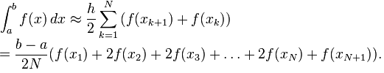
Homework Assignment
A definite integral can be computed numerically by trapezoidal approximation:
Where x_{k} = a + kh for k = 1, … N. Write a class called DefInt to compute the trapezoidal approximation for a given function f(x). The class should contain the following:
Private members to hold the values of the integration limits a and b and a pointer to the function f.
A constructor function such that the integration limits a, b and the pointer to the function f can be initiated a the time of creating an object of the class such as DefInt MyInt(a, b, f)
A public function ByTrapzoid() taking N as an argument and returning the trapezoidal approximation to the integral when called by MyInt.ByTrapzoidal(N).
You may also want to include another public function BySimpson() to compute the Simpson approximation to the integral (look it up in the literature).

Slide 122
Inheritance
EurOption
Call
Put

Slide 123
Inheritance Concept
class Rectangle {
private:
int numVertices;
float xCoord, yCoord;
public:
void set(float x, float y, int nV);
float area();
};
Polygon
Rectangle
Triangle
class Polygon {
private:
int numVertices;
float xCoord, yCoord;
public:
void set(float x, float y, int nV);
};
class Triangle{
private:
int numVertices;
float xCoord, yCoord;
public:
void set(float x, float y, int nV);
float area();
};

Slide 124
Inheritance Concept
class Polygon{
protected:
int numVertices;
float xCoord, float yCoord;
public:
void set(float x, float y, int nV);
};
Polygon
Rectangle
Triangle
class Rectangle{
protected:
int numVertices;
float xCoord, float yCoord;
public:
void set(float x, float y, int nV);
float area();
};
Child(derived) parent(base)
class Rectangle : public Polygon{
public:
float area();
};

Slide 125
Inheritance Concept
class Polygon{
protected:
int numVertices;
float xCoord, float yCoord;
public:
void set(float x, float y, int nV);
};
Polygon
Rectangle
Triangle
class Triangle{
protected:
int numVertices;
float xCoord, float yCoord;
public:
void set(float x, float y, int nV);
float area();
};
class Triangle : public Polygon{
public:
float area();
};

Slide 126
Inheritance Concept
class Point{
protected:
int x, y;
public:
void set (int a, int b);
};
Point
x
y
Circle
3D-Point
x
y
r
x
y
z
class Circle : public Point{
private:
double r;
};
class 3D-Point: public Point{
private:
int z;
};

Slide 127
Inheritance Concept
Augmenting the original class
Specializing the original class
Point
Circle
3D-Point
Polygon
Rectangle
Triangle

Slide 128
Why Inheritance ?
  Inheritance is a mechanism for
    building class types from existing class types
    defining new class types to be a
      specialization
      augmentation
    of existing types

Slide 129
Define a Class Hierarchy
Syntax:
class DerivedClassName : access-level BaseClassName
where
  access-level specifies the type of derivation
    private by default, or
    public
Any class can serve as a base class
  Thus a derived class can also be a base class

Slide 130
Class Derivation
Point is the base class of 3D-Point, while 3D-Point is the base class of Sphere
Parent
Child
Grandchild
Point
class Point{
protected:
int x, y;
public:
void set (int a, int b);
};
3D-Point
Sphere
class 3D-Point : public Point{
private:
double z;
… …
};
class Sphere : public 3D-Point{
private:
double r;
… …
};

Slide 131
What to inherit?
In principle, every member of a base class is inherited by a derived class
  just with different access permission

Slide 132
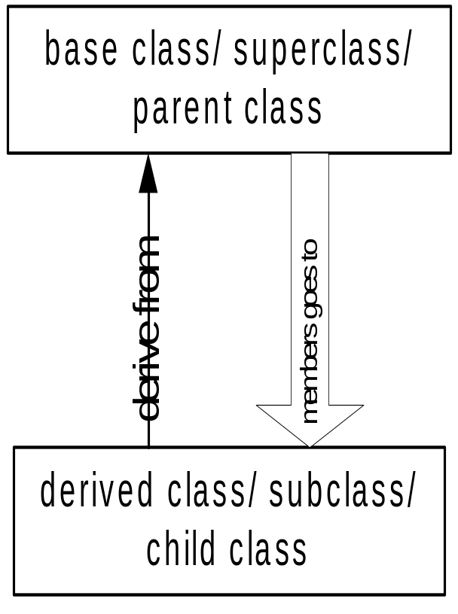
Access Control Over the Members
Two levels of access control over class members
  class definition
  inheritance type
class Point{
protected: int x, y;
public: void set(int a, int b);
};
class Circle : public Point{
… …
};

Slide 133
What to inherit?
In principle, every member of a base class is inherited by a derived class
  just with different access permission
However, there are exceptions for
  constructor and destructor
  operator=() member
  friends
Since all these functions are class-specific

Slide 134
Constructor Rules for Derived Classes
The default constructor and the destructor of the base class are always called when a new object of a derived class is created or destroyed.
class A {
public:
A ( )
{cout<< “A:default”<<endl;}
A (int a)
{cout<<“A:parameter”<<endl;}
};
class B : public A
{
public:
B (int a)
{cout<<“B”<<endl;}
};
output:
A:default
B
B test(1);

Slide 135
Constructor Rules for Derived Classes
You can also specify an constructor of the base class other than the default constructor
  DerivedClassCon ( derivedClass args ) : BaseClassCon ( baseClass args )
  { DerivedClass constructor body }
class A {
public:
A ( )
{cout<< “A:default”<<endl;}
A (int a)
{cout<<“A:parameter”<<endl;}
};
class C : public A {
public:
C (int a) : A(a)
{cout<<“C”<<endl;}
};
output:
A:parameter
C
C test(1);

Slide 136
Define its Own Members
class Point{
protected:
int x, y;
public:
void set(int a, int b);
};
The derived class can also define its own members, in addition to the members inherited from the base class
Point
x
y
x
y
r
Circle
class Circle{
protected:
int x, y;
private:
double r;
public:
void set(int a, int b);
void set_r(double c);
};
class Circle : public Point{
private:
double r;
public:
void set_r(double c);
};
void set（double c）
void set（double c）
Overloaded！

Slide 137
Even more …
A derived class can override methods defined in its parent class. With overriding,
  the method in the subclass has the identical signature to the method in the base class.
  a subclass implements its own version of a base class method.
class A {
protected:
int x, y;
public:
void print ()
{cout<<“From A”<<endl;}
};
class B : public A {
public:
void print ()
{cout<<“From B”<<endl;}
};

Slide 138
Access a Method
class Point{
protected:
int x, y;
public:
void set(int a, int b)
{x=a; y=b;}
void foo ();
void print();
};
class Circle : public Point{
private: double r;
public:
void set (int a, int b, double c) {
Point :: set(a, b); //same name function call
r = c;
}
void print(); };
Circle C;
C.set(10,10,100); // from class Circle
C.foo (); // from base class Point
C.print(); // from class Circle
Point A;
A.set(30,50); // from base class Point
A.print(); // from base class Point

Slide 139
Putting Them Together
Time is the base class
ExtTime is the derived class with public inheritance
The derived class can
  inherit all members from the base class, except the constructor
  access all public and protected members of the base class
  define its private data member
  provide its own constructor
  define its public member functions
  override functions inherited from the base class
Time
ExtTime

Slide 140
class Time Specification
// SPECIFICATION FILE ( time.h)
class Time{
public :
void Set ( int h, int m, int s ) ;
void Increment ( ) ;
void Write ( ) const ;
Time ( int initH, int initM, int initS ) ; // constructor
Time ( ) ; // default constructor
protected :
int hrs ;
int mins ;
int secs ;
} ;

Slide 141
Class Interface Diagram
Time class
Set
Protected data:
hrs
mins
secs
Increment
Write
Time
Time

Slide 142
Derived Class ExtTime
// SPECIFICATION FILE ( exttime.h)
#include “time.h”
enum ZoneType {EST, CST, MST, PST, EDT, CDT, MDT, PDT } ;
class ExtTime : public Time
// Time is the base class and use public inheritance
{
public :
void Set ( int h, int m, int s, ZoneType timeZone ) ;
void Write ( ) const; //overridden
ExtTime (int initH, int initM, int initS, ZoneType initZone ) ;
ExtTime (); // default constructor
private :
ZoneType zone ; // added data member
} ;

Slide 143
Class Interface Diagram
ExtTime class
Set
Set
Increment
Increment
Protected data:
hrs
mins
secs
Write
Write
ExtTime
Time
ExtTime
Time
Private data:
zone

Slide 144
Implementation of ExtTime
Default Constructor
ExtTime :: ExtTime ( )
{
zone = EST ;
}
ExtTime et1;
et1
hrs = 0
mins = 0
secs = 0
zone = EST
The default constructor of base class, Time(), is automatically called, when an ExtTime object is created.

Slide 145
Implementation of ExtTime
Another Constructor
ExtTime :: ExtTime (int initH, int initM, int initS, ZoneType initZone)
: Time (initH, initM, initS)
// constructor initializer
{
zone = initZone ;
}
ExtTime *et2 =
new ExtTime(8,30,0,EST);
5000
hrs = 8
mins = 30
secs = 0
zone = EST
et2
6000
???
5000

Slide 146
Implementation of ExtTime
void ExtTime :: Set (int h, int m, int s, ZoneType timeZone)
{
Time :: Set (h, m, s); // same name function call
zone = timeZone ;
}
void ExtTime :: Write ( ) const // function overriding
{
string zoneString[8] =
{“EST”, “CST”, MST”, “PST”, “EDT”, “CDT”, “MDT”, “PDT”} ;
Time :: Write ( ) ;
cout <<‘ ‘<<zoneString[zone]<<endl;
}
zoneString[PDT]
=
zoneString[7]
STL string class
String const

Slide 147
Working with ExtTime
#include “exttime.h”
… …
int main()
{
ExtTime thisTime ( 8, 35, 0, PST ) ;
ExtTime thatTime ; // default constructor called
thatTime.Write( ) ; // outputs 00:00:00 EST
thatTime.Set (16, 49, 23, CDT) ;
thatTime.Write( ) ; // outputs 16:49:23 CDT
thisTime.Increment ( ) ;
thisTime.Increment ( ) ;
thisTime.Write ( ) ; // outputs 08:35:02 PST
}

Slide 148
Option05.h
  #ifndef Options05_h
  #define Options05_h
  #include "BinModel02.h"
  class EurOption
  {
  private:
  //steps to expiry
  int N;
  //pointer to payoff function
  double (*Payoff)(double z, double K);
  public:
  void SetN(int N_) {N=N_;}
  void SetPayoff(double (*Payoff_)(double z, double K)) {Payoff=Payoff_;}
  //pricing European option
  double PriceByCRR(BinModel Model, double K);
  };

Slide 149
Details of class EurOption:
The EurOption class has two private variables:
  N of type int to hold the number of steps to expiry date.
  Payoff, a pointer to a function that takes two arguments of type double and returns a value of type double. It will be used as a pointer to the payoff function. The payoff function itself is not defined within this class, in line with the idea that the EurOption class should cater for an arbitrary payoff.
The EurOption class three public functions:
  SetN(), which does not return any value – void
  SetPayOff(), to set the pointer to the payoff function once it is decided which concrete option is to be priced.
  PriceByCRR(), the option pricer

Slide 150
//computing call payoff
double CallPayoff(double z, double K); //independent func
class Call: public EurOption
{
private:
double K; //strike price
public:
Call(){SetPayoff(CallPayoff);}
double GetK(){return K;}
int GetInputData();
};

Slide 151
//computing put payoff
double PutPayoff(double z, double K);
class Put: public EurOption
{
private:
double K; //strike price
public:
Put(){SetPayoff(PutPayoff);}
double GetK(){return K;}
int GetInputData();
};

Slide 152
Derived Classes: Call and Put
class Call:public EurOption
  Introduce Call as a subclass of the EurOption class. There is also a similar class for puts.
  The keyword, public, is for controlling access rights:
    All public members of the base class EurOption become public members of the subclasses.
    The private members of the base class are always private to subclasses.
  It is also possible to introduce private subclasses:
    All public members of the base class become private members of subclasses.

Slide 153
The protected members:
  A protected nonstatic base class member can be accessed by members and friends of any classes derived from that base class by using one of the following:
    A pointer to a directly or indirectly derived class
    A reference to a directly or indirectly derived class
    An object of a directly or indirectly derived class
    If a class is derived privately from a base class, all protected base class members become private members of the derived class.
We do not have protected members now, but will use it down the road.

Slide 154
The Call class (and similarly the Put class) has three more public functions in addition to those inherited from EurOption:
  Constructor function:
    Call(){SetPayoff(CallPayoff);}
    Constructor functions are executed automatically whenever an object of the corresponding class is initialized.
      In main(): Call Option1;
      The constructor function will run behind the scenes and set the function pointer, Payoff, to point to the CallPayoff().
  GetK() will allow code outside the class to look up the new private variable, k.
  GetInputData() is self-explanatory.

Slide 155
Option05.cpp
    #include "Options05.h"
    #include "BinModel02.h"
    #include <iostream>
    #include <cmath>
    using namespace std;
    double EurOption::PriceByCRR(BinModel Model, double K)
    { double q=Model.RiskNeutProb();
    double Price[N+1];
    for (int i=0; i<=N; i++)
    { Price[i]=Payoff(Model.S(N,i),K);
    }
    for (int n=N-1; n>=0; n--)
    {
    for (int i=0; i<=n; i++)
    {
    Price[i]=(q*Price[i+1]+(1-q)*Price[i]) /(1+Model.GetR());
    }
    }
    return Price[0];
}
Notes:
If Payoff is not a virtual function any more (the keyword virtual is off from the base class), the Payoff function in the base class will be used, which returns 0.0:
Enter S0: 106
Enter U: 0.15145
Enter D: -0.13138
Enter R: 0.00545
Input data checked
There is no arbitrage
Enter call option data:
Enter steps to expiry N: 8
Enter strike price K: 100
European call option price = 0
Enter put option data:
Enter steps to expiry N:

Slide 156
double CallPayoff(double z, double K) //independent func
{
if (z>K) return z-K;
return 0.0;
}
int Call::GetInputData()
{
cout << "Enter call option data:" << endl;
int N;
cout << "Enter steps to expiry N: "; cin >> N;
SetN(N);
cout << "Enter strike price K: "; cin >> K;
cout << endl;
return 0;
}

Slide 157
double PutPayoff(double z, double K)
{
if (z<K) return K-z;
return 0.0;
}
int Put::GetInputData()
{
cout << "Enter put option data:" << endl;
int N;
cout << "Enter steps to expiry N: "; cin >> N;
SetN(N);
cout << "Enter strike price K: "; cin >> K;
cout << endl;
return 0;
}
In GetInputData(), as N is a private variable from the base class, the subclass has no direct access to it and have to use the SetN() function belonging to the EurOption class.

Slide 158
Main09.cpp
Destroy order
1. Model (the copy one)
2. Option2 : ~Put()
~EurOption()
3. Option1 : ~Call()
~EurOption()
4. Model: ~BinModel()
#include "BinModel02.h"
#include "Options05.h"
#include <iostream>
#include <cmath>
using namespace std;
int main()
{
BinModel Model; //create by default constructor of BinModel
if (Model.GetInputData()==1) return 1;
Call Option1; //1. EurOption() -> N=0; PayOff = NULL
//2. Call() -> K=0.0; PayOff = & CallPayOff
Option1.GetInputData();
cout << "European call option price = " << Option1.PriceByCRR(Model,Option1.GetK()) << endl << endl;
//Copy of model, created by copy/constructor of BinModel
Put Option2; //1. EurOption() 2. Put()
Option2.GetInputData();
cout << "European put option price = " << Option2.PriceByCRR(Model,Option2.GetK()) << endl << endl;
return 0;
}

Slide 159
Virtual Functions
By default, C++ matches a function call with the correct function definition at compile time. This is called static binding. You can specify that the compiler match a function call with the correct function definition at run time; this is called dynamic binding. You declare a function with the keyword virtual if you want the compiler to use dynamic binding for that specific function.
A virtual function is a member function you may redefine for other derived classes, and can ensure that the compiler will call the redefined virtual function for an object of the corresponding derived class, even if you call that function with a pointer or reference to a base class of the object.
A class that declares or inherits a virtual function is called a polymorphic class.

Slide 160
Why Polymorphism?--Review:
Time and ExtTime Example by Inheritance
void Print (Time someTime ) //pass an object by value
{
cout << “Time is “ ;
someTime.Write ( ) ;
cout << endl ;
}
CLIENT CODE
Time startTime ( 8, 30, 0 ) ;
ExtTime endTime (10, 45, 0, CST) ;
//Will lose data!
Print ( startTime ) ;
Print ( endTime ) ;
// Time :: write()
OUTPUT
Time is 08:30:00
Time is 10:45:00

Slide 161
Static Binding
When the type of a formal parameter is a parent class, the argument used can be:
the same type as the formal parameter,
or,
any derived class type.
Static binding is the compile-time determination of which function to call for a particular object based on the type of the formal parameter
When pass-by-value is used, static binding occurs

Slide 162
Can we do better?
void Print (Time someTime ) //pass an object by value
{
cout << “Time is “ ;
someTime.Write ( ) ;
cout << endl ;
}
CLIENT CODE
Time startTime ( 8, 30, 0 ) ;
ExtTime endTime (10, 45, 0, CST) ;
Print ( startTime ) ;
Print ( endTime ) ;
// Time :: write()
OUTPUT
Time is 08:30:00
Time is 10:45:00

Slide 163
Polymorphism – An Introduction
noun, the quality or state of being able to assume different forms - Webster
An essential feature of an OO Language
It builds upon Inheritance
Allows run-time interpretation of object type for a given class hierarchy
  Also Known as “Late Binding”
Implemented in C++ using virtual functions

Slide 164
Dynamic Binding
Is the run-time determination of which function to call for a particular object of a derived class based on the type of the argument
Declaring a member function to be virtual instructs the compiler to generate code that guarantees dynamic binding
Dynamic binding requires pass-by-reference or call by pointer.

Slide 165
Virtual Member Function
// SPECIFICATION FILE ( time.h )
class Time
{
public :
. . .
virtual void Write ( ) ; // for dynamic binding
virtual ~Time(); // destructor
private :
int hrs ;
int mins ;
int secs ;
} ;

Slide 166
This is the way we like to see…
void Print (Time * someTime )
{
cout << “Time is “ ;
someTime->Write ( ) ;
cout << endl ;
}
OUTPUT
Time is 08:30:00
Time is 10:45:00 CST
CLIENT CODE
Time startTime( 8, 30, 0 ) ;
ExtTime endTime(10, 45, 0, CST) ;
Time *timeptr;
timeptr = &startTime;
Print ( timeptr ) ;
timeptr = &endTime;
Print ( timeptr ) ;
Time::write()
ExtTime::write()

Slide 167
Virtual Functions
Virtual Functions overcome the problem of run time object determination
Keyword virtual instructs the compiler to use late binding and delay the object interpretation
How ?
  Define a virtual function in the base class. The word virtual appears only in the base class
  If a base class declares a virtual function, it must implement that function, even if the body is empty
  Virtual function in base class stays virtual in all the derived classes
  It can be overridden in the derived classes
  But, a derived class is not required to re-implement a virtual function. If it does not, the base class version is used

Slide 168
Polymorphism Summary:
When you use virtual functions, compiler store additional information about the types of object available and created
Polymorphism is supported at this additional overhead
Important :
  virtual functions work only with pointers/references
  Not with objects even if the function is virtual
  If a class declares any virtual methods, the destructor of the class should be declared as virtual as well.

Slide 169
Abstract Classes & Pure Virtual Functions
Some classes exist logically but not physically.
Example : Shape
  Shape s; // Legal but silly..!! : “Shapeless shape”
  Shape makes sense only as a base of some classes derived from it. Serves as a “category”
  Hence instantiation of such a class must be prevented
class Shape //Abstract
{
public :
//Pure virtual Function
virtual void draw() = 0;
}
A class with one or more pure virtual
functions is an Abstract Class
Objects of abstract class can’t be
created
Shape s; // error : variable of an abstract class

Slide 170
Example
Shape
virtual void draw()
Circle
Triangle
public void draw()
public void draw()

Slide 171
A pure virtual function not defined in the derived class remains a pure virtual function.
Hence derived class also becomes abstract
class Circle : public Shape { //No draw() - Abstract
public :
void print(){
cout << “I am a circle” << endl;
}
class Rectangle : public Shape {
public :
void draw(){ // Override Shape::draw()
cout << “Drawing Rectangle” << endl;
}
Rectangle r; // Valid
Circle c; // error : variable of an abstract class

Slide 172
Pure virtual functions : Summary
Pure virtual functions are useful because they make explicit the abstractness of a class
Tell both the user and the compiler how it was intended to be used
Note : It is a good idea to keep the common code as close as possible to the root of you hierarchy

Slide 173
Summary ..continued
It is still possible to provide definition of a pure virtual function in the base class
The class still remains abstract and functions must be redefined in the derived classes, but a common piece of code can be kept there to facilitate reuse
In this case, they can not be declared inline
class Shape { //Abstract
public :
virtual void draw() = 0;
};
// OK, not defined inline void Shape::draw(){
cout << “Shape" << endl;
}
class Rectangle : public Shape
{
public :
void draw(){
Shape::draw(); //Reuse
cout <<“Rectangle”<< endl;
}

Slide 174
Options06.h
#define Options06_h
#include "BinModel02.h"
class EurOption
{
private:
int N; //steps to expiry
public:
void SetN(int N_){N=N_;}
//Payoff defined to return 0.0
//for pedagogical purposes.
//To use a pure virtual function replace by
//virtual double Payoff(double z)=0;
virtual double Payoff(double z){return 0.0;}
//pricing European option
double PriceByCRR(BinModel Model);
};

Slide 175
class Call: public EurOption
{
private:
double K; //strike price
public:
void SetK(double K_){K=K_;}
int GetInputData();
double Payoff(double z);
};
class Put: public EurOption
{
private:
double K; //strike price
public:
void SetK(double K_){K=K_;}
int GetInputData();
double Payoff(double z);
};

Slide 176
Options06.cpp
#include "Options06.h"
#include "BinModel02.h"
#include <iostream>
#include <cmath>
using namespace std;
double EurOption::PriceByCRR(BinModel Model)
{ double q=Model.RiskNeutProb();
double Price[N+1];
for (int i=0; i<=N; i++) { Price[i]=Payoff(Model.S(N,i)); }
for (int n=N-1; n>=0; n--) //this -> PayOff(Model.S(N,i));
{ for (int i=0; i<=n; i++)
{
Price[i]=(q*Price[i+1]+(1-q)*Price[i])/(1+Model.GetR());
}
}
return Price[0];
}

Slide 177
int Call::GetInputData()
{
cout << "Enter call option data:" << endl;
int N;
cout << "Enter steps to expiry N: "; cin >> N;
SetN(N);
cout << "Enter strike price K: "; cin >> K;
cout << endl;
return 0;
}
double Call::Payoff(double z)
{
if (z>K) return z-K;
return 0.0;
}

Slide 178
int Put::GetInputData()
{ cout << "Enter put option data:" << endl;
int N;
cout << "Enter steps to expiry N: "; cin >> N;
SetN(N);
cout << "Enter strike price K: "; cin >> K;
cout << endl;
return 0;
}
double Put::Payoff(double z)
{
if (z<K) return K-z;
return 0.0;
}

Slide 179
Main10.cpp
#include "BinModel02.h"
#include "Options06.h"
#include <iostream>
#include <cmath>
using namespace std;
int main()
{ BinModel Model;
if (Model.GetInputData()==1) return 1;
Call Option1;
Option1.GetInputData();
cout << "European call option price = " << Option1.PriceByCRR(Model) << endl << endl;
Put Option2; //Current object is Option1, this = &Option1
Option2.GetInputData();
cout << "European put option price = " << Option2.PriceByCRR(Model) << endl << endl;
return 0;
}

Slide 180
Using virtual function, the design of the 3 classes is much cleaner:
  No function pointer in the base class, EurOption
  No SetPayOff() function any more.
  No constructor functions calling SetPayOff()
  We add virtual function, PayOff() to the base class:
    virtual double Payoff(double z){return 0.0;}
  The derived classes, Call and Put, redefine the virtual function for its corresponding functionality:
double Call::Payoff(double z)
{ if (z>K) return z-K;
return 0.0; }
double Put::Payoff(double z)
{ if (z<K) return K-z;
return 0.0; }

Slide 181
We could further improve the base class by convert the virtual function, PayOff() to a pure virtual function:
  virtual double Payoff(double z)=0;
The class containing a pure virtual function is called an abstract class.
    We have the abstract of European option represented by the abstract EuroOption class!

Slide 182
An abstract class is a class that is designed to be specifically used as a base class. An abstract class contains at least one pure virtual function. You declare a pure virtual function by using a pure specifier (= 0) in the declaration of a virtual member function in the class declaration.
You cannot declare an instance of an abstract base class; you can use it only as a base class when declaring other classes.
An abstract class is used to define an implementation and is intended to be inherited from by concrete classes. It's a way of forcing a contract between the class designer and the users of that class.

Slide 183
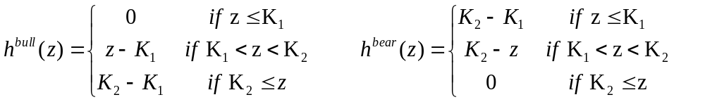
Homework Assignment
Add the ability to price bull spreads and bear spreads by introducing new subclasses BullSpread and BearSpread of EurOption class defined in Options06.h. Use the new classes, making suitable changes in Main10.cpp to price European bull and bear spreads.

Slide 184
Pricing Double-digital Options
#ifndef DoubDigitOpt_h
#define DoubDigitOpt_h
#include "Options06.h"
class DoubDigitOpt: public EurOption
{
private:
double K1; //parameter 1
double K2; //parameter 2
public:
int GetInputData();
double Payoff(double z);
};
#endif

Slide 185
DoubleDigitOpt.cpp
  #include "DoubDigitOpt.h"
  #include <iostream>
  using namespace std;
  int DoubDigitOpt::GetInputData()
  { cout << "Enter double-digital option data:" << endl;
  int N;
  cout << "Enter steps to expiry N: "; cin >> N;
  SetN(N);
  cout << "Enter parameter K1: "; cin >> K1;
  cout << "Enter parameter K2: "; cin >> K2;
  cout << endl;
  return 0;
  }
  double DoubDigitOpt::Payoff(double z)
  { if (K1<z && z<K2) return 1.0;
  return 0.0;
  }

Slide 186
Main11.cpp
#include "BinModel02.h"
#include "Options06.h"
#include "DoubDigitOpt.h"
#include <iostream>
#include <cmath>
using namespace std;
int main()
{
BinModel Model;
if (Model.GetInputData()==1)
return 1;
Call Option1;
Option1.GetInputData();
cout << "European call option price = " << Option1.PriceByCRR(Model) << endl << endl;
Put Option2;
Option2.GetInputData();
cout << "European put option price = " << Option2.PriceByCRR(Model) << endl << endl;
DoubDigitOpt Option3;
Option3.GetInputData();
cout << "European double-digital option price = " << Option3.PriceByCRR(Model) << endl << endl;
return 0;
}

Slide 187
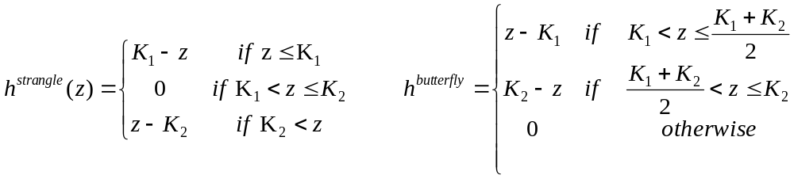
Homework Assignment
Add further payoffs, namely, strangle, and butterfly spreads, by means of subclasses of the EuroOption class placed in separate files, without changing anything in existing code, except for the necessary changes in Main11.cpp, to price options with the newly introduced payoffs.

Slide 188
References
Numerical Methods in Finance with C++ (Mastering Mathematical Finance), by Maciej J. Capinski and Tomasz Zastawniak, Cambridge University Press, 2012, ISBN-10: 0521177162
Introduction to software development, David Megias Jimenz, Jordi Mas, Josep Anton Perez Lopez and Lluis Ribas Xirgo, www.uoc.edu
IBM XL C/C++ V8.0 for AIX, publib.boulder.ibm.com/infocenter/comphelp/v8v101
Starting Out with C++ Early Objects, Seventh Edition, by Tony Gaddis, Judy Walters, and Godfrey Muganda, ISBN 0-13-607774-9, Addison-Wesley, 2010
web.cse.ohio-state.edu/~neelam/courses/45922/Au05Somasund/

